Slide 1
Module 5
Syllabus
Data-flow computers - Data driven computing and Languages - Data flow computers architectures - Static data flow computer -Dynamic data flow computer -Data flow design alternatives.

Slide 2
DATA-DRIVEN COMPUTING AND LANGUAGES
Data flow computers are based on the concept of data-driven computation, which is drastically different from the operation of a conventional von Neumann ma­chine.
The fundamental difference is that instruction execution in a conventional computer is under program-flow control, whereas that in a data flow computer is driven by the data (operand) availability
The data flow model offers an approach to meet these demands.
to achieve a high performance/cost ratio
to match the ratio with technological progress
to offer better programmability in application areas.

Slide 3
Control Flow vs. Data Flow Computers
Control Flow Computers
a = (b+1) * (b - c) is specified by a series of instructions with an explicit flow of control.
Shared memory cells are the means by which data is passed between instructions. Data (operands) are referenced by their memory addresses (variables).
In Figure , solid arcs show the access to stored data, while dotted arcs indicate the flow of control.
In the traditional sequential control flow model (von Neumann), there is a single thread of control, which is passed from instruction to instruction.
Explicit control transfers are caused by using operators like GO TO.
In the parallel control flow model special parallel control operators such as FORK and JOIN are used to explicitly specify parallelism.

Slide 4
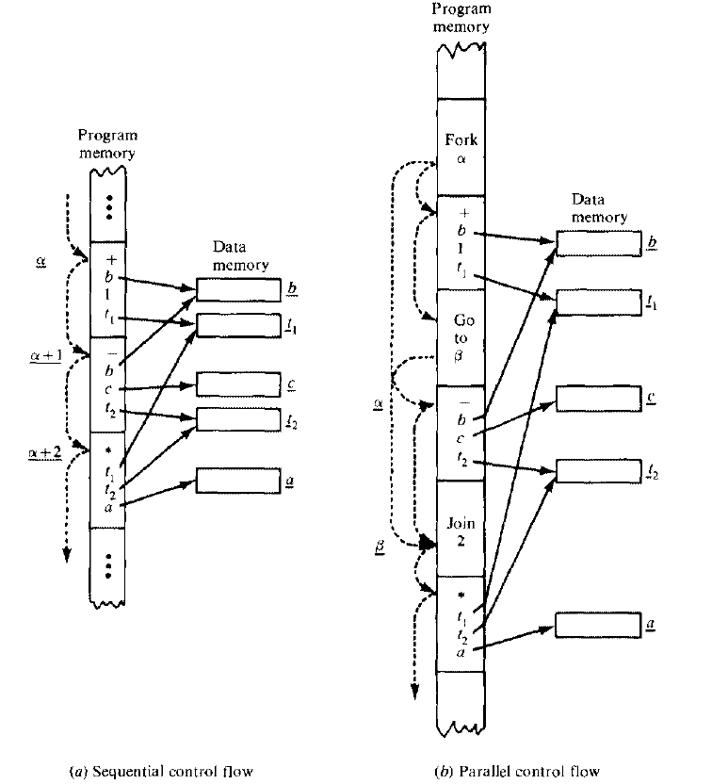
a=(b+1)*(b-c)

Slide 5
These operators allow more than one thread of control to be active at an instant and provide means for synchronizing these threads
Special features are identified below for either the sequential or parallel control flow model:
Data is passed between instructions via references to shared memory celts.
Flow of control is implicitly sequential, but special control operators can be used explicitly for parallelism.
Program counters are used to sequence the execution of instruction in a centralized control environment.

Slide 6
Data Flow computers
In a data flow computing environment, instructions are activated by the availability of data tokens as indicated by the ( ) in Figure below.
Data flow pro­grams are represented by directed graphs, which show the flow of data between instructions.
Each instruction consists of an operator, one or two operands, and one or more destinations to which the result (data token) will be sent.
The dots correspond to data tokens being passed between instructions.
features in the data flow model
Intermediate or final results are passed directly as data token between instructions.
There is no concept of shared data storage as embodied in the traditional notion of a variable.
Program sequencing is constrained only by data dependency among instructions.

Slide 7
Control flow computers have a control-driven organization. This means that the program has complete control over instruction sequencing.
Synchronous computations are performed in control flow computers using centralized control.
Data flow computers have a data-driven organization that is characterized by a passive examine stage.
Instructions are examined to reveal the operand availability, upon which they are executed immediately if the functional units are available.

Slide 8
(b)
(c)
+ ( ) 1 β
- ( ) ( ) β
* ( ) ( ) δ/1
(a)
Instruction execution in a data flow for the computer
for computation of a=(b+1)*(b-c) by data forwarding

Slide 9
This data-driven concept means asynchrony, which means that many instruc­tions can be executed simultaneously and asynchronously.
A high degree of implicit parallelism is expected in a data flow computer.
Because there is no use of shared memory cells, data flow programs are free from side effects.
Operands are directly passed as "tokens" of values instead of as "address" variables.
Information items in a data flow computer appear as operation packets and data tokens.
An operation packet is composed of the opcode, operands, and destinations of its successor instructions
A data token is formed with a result value and its destinations.

Slide 10
(3)=b
(5)=c
+(1)
-
Step 1
*
(5)=c
+(1)
-
(4)
(-2)
Step 2
*
+(1)
-
Step 3
*
(-8)=a

Slide 11
Data flow machine architectures
Depending on the way of handling data tokens, data flow computers are divided into the static model and the dynamic model

Slide 12
In static data flow machine, data tokens are assumed to move along the arcs of the data flow program graph to the operator nodes.
The nodal operation gets executed when all its operand data are present at the input arcs.
Only one token is allowed to exist on any arc at any given time, otherwise the successive sets of tokens cannot be distinguished. This architecture is considered static because tokens are not labeled and control tokens must be used to acknowledge the proper timing in transferring data tokens from node to node.
The data tokens are in the input pool of the update unit. This update unit passes data tokens to their destination instructions in the memory unit. When an instruction receives all its required operand tokens, it is enabled and forwarded to the enabled queue. The fetch unit fetches these instructions when they become enabled.

Slide 13
Static dataflow computer organization
Memory unit
(instructions)
Update
unit
Fetch
unit
(Instruction address)
Data
tokens
Processing unit
(processors)
Enabled
Instruction queue

Slide 14
A dynamic data flow machine uses tagged tokens, so that more than one token can exist in an arc.
The tagging is achieved by attaching a label with each token which uniquely identifies the context of that particular token.
This dynamically tagged data flow model suggests that maximum parallelism can be exploited from a program graph.

Slide 15
The system synchronization is based on a matching mechanism, Data tokens form the input pool of the matching unit.
This matching unit arranges data token into pairs or sets and temporarily stores each token until all operands are compared, whereupon the matched token sets are released to the fetch-update unit.
Each set of matched data tokens (usually two for binary operations) is needed for one instruction execution.
The fetch-update unit forms the enabled instructions by merging the token sets with copies sent to their consumer instruc­tions.
The matching of the special lags attached to the data tokens can unfold iterative loops for parallel computations. We shall further discuss this tagged-token concept in later sections

Slide 16
Dynamic dataflow computer organization
Memory unit
(instructions)
Matching
unit
(Matched token sets
Update/
fetch unit
Processing unit
(Processors)
Data
tokens
Enabled
Instruction queue

Slide 17
A ring structured data-flow computer organization
including the I/O functions
Input
Output
Input-output section
(token matching)
Routing network
Memory section
(instructions)
Processing section
(Processors)
(Data tokens)

Slide 18
The ring contains four resource sections: the memories, the processors, the routing network, and the input-output unit.
The memories are used to hold the instruction packets, The processing units form the task force for parallel execution of enabled instructions.
The routing network is used to pass the result tokens to their destined instructions.
The input-output unit serves as an interface between the data flow computer and the outside world.
For dynamic machines, the token matching is performed by the I/O section.

Slide 19
Major design issues
The development of efficient data flow languages which are easy to use and to be interpreted by machine hardware
The decomposition of programs and the assignment of program modules to data flow processors
Controlling and supporting large amounts of interprocessor communication with cost-effective packet-switched networks
Developing intelligent data-driven mechanisms for either static or dynamic data flow machines
Efficient handling of complex data structures, such as arrays, in a data flow environment
Developing a memory hierarchy and memory allocation schemes for supporting data flow computations
A large need for user acquaintance of functional data flow languages, software supports, data flow compiling, and new programming methodologies
Performance evaluation of data flow hardware in a large variety of application domains, especially in the scientific areas

Slide 20
Data Flow Graphs and Languages

Slide 21
An efficient data flow language should be able to express parallelism in a program more naturally, to promote programming pro­ductivity, and to facilitate close interactions between algorithm constructs and hardware structures.
Examples of data flow languages include the Irvine Data­flow (ID) language and the Value Algorithmic Language (VAL) among several single assignment and functional programming languages
roProperties
Freedom from side effectsamming
Locality of effect without far-reaching data dependencies
Equivalence of instruction-sequencing constraints with data dependencies
Satisfying single-assignment rule with aliasing
Unfolding of iterative computations into parallelism
Lack of "history sensitivity" in procedures calls

Slide 22
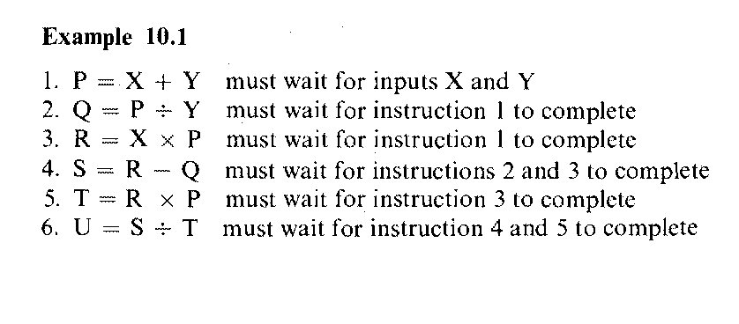

Slide 23
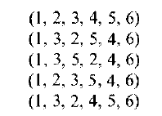
Permissible computation sequences of the above program on a serial computer include the following five:
On a parallel computer, it is possible to perform these six operations (1, [2 and 3 simultaneously], [4 and 5 simultaneously]. 6) in three steps instead of six steps.
(1 (1 (1 fl
A data flow graph is a directed graph whose nodes correspond to operators and arcs are pointers for forwarding data tokens. The graph demon­strates sequencing constraints (consistent with data dependencies) among instruc­tions.

Slide 24
P = X + Y
Q = P / Y
R = X * P
S = R – Q
T = R * P
U = S / T
f(X,Y)=(X * (X+Y)-(X+Y)/Y)/(X * (X+Y) * (X+Y))

Slide 25
X
Y
+
P
*
/
Q
R
-
*
S
T
/
U

Slide 26
Nodes and links for construction of the dataflow graphs
Data link
Boolean link
Identity
Decider
Operator
f
I
T gate
F gate
Merge
T
F
T F

Slide 27
Numerical data links transmit integer, real, or complex numbers and boolean links carry only boolean values for control purposes.
An identity operator is a special operator that has one input arc and transmits its input value unchanged.
Deciders, gates, and merge operators are used to represent conditional or iterative compu­tation in data flow graphs. A decider requires a value from each input arc and produces the truth value resulting from applying the predicate P to the values received.
Control tokens bearing boolean values control the flow of data tokens by means of the T gates, the F gates, and the merge operators.
A T gate passes a data token from its data input arc to its output arc when it receives the true value on its control input arc. It will absorb a data token from its data input arc and place nothing on its output arc if it receives a false value

Slide 28
A merge operator T & F are data input, arcs and a truth-value control arc. When a truth value is received, the merge actor places the token from the true input arc on its output arc.
The token on the other unused input arc is discarded. Similarly, the false input is passed to the output, when the control arc is false.
An F gate has similar behavior, except the sense of the control value is reversed.

Slide 29
Input x,n
Y=1;i=n;
While i > 0 do
Begin y=y*x;i=i-1; end
z=y
Output z

Slide 30
X
1
n
T F
false
T F
false
T F
false
i
>0
T
F
T
T
*
-1
z

Slide 31
The successive values assumed by the loop variables y and i pass through the links labeled in the program graph.
The decider emits a token carrying the true value each time execution of the loop body is required. When the firing of the decider yields a false, the value of y is routed to the output link z.
Note the presence of tokens carrying false values on the input arcs of the merge operators. These tokens allow the merge operator to initiate execution of the loop by passing initial values for the loop variables.
The initial values of the control token are marked as false

Slide 32
Locality of effect
This means that global assignments and common variables should be avoided. Data flow languages generally exhibit considerable locality. Assignment to a formal para­meter should be within a definite range. Therefore, block structures arc highly welcome in a data flow language.
Freedom from side effects
Another problem comes from the aliasing of parameters. Data flow languages provide "call by value" instead of the "call by reference." This essentially solves the aliasing problem. Instead of having a pro­cedure modify its arguments, a "call by value" procedure copies its arguments. Thus, it can never modify the arguments passed from the calling program. In other words, inputs and outputs arc totally isolated to avoid unnecessary side effects.

Slide 33
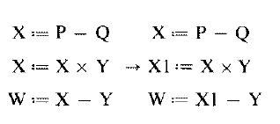
Single assignment rule
This offers method to promote parallelism in a program. The rule is to forbid the use of the same variable name more than once on the left-hand side of any statement. In other words, a new name is chosen for any redefined variable, and all subsequent references are changed to the new name
Unfolding iterations
A programming language cannot be considered as effective if it cannot be used to implement iterative computations efficiently. In order to achieve parallel processing, iterative computations must be unfolded. Techniques have been suggested to use tagged tokens to unfold activities.

Slide 34
Advantages
Highly concurrent operations
The data flow approach offers a possible solution to the problem of efficiently exploiting concurrency of computation on a large scale. The direct use of values instead of names of value containers (addresses) enables purely functional programming without side effects. Asynchronous parallelism can be exploited at the instruction level or at the procedure level.
The data flow language does not introduce instruction-sequencing constraints other than the ones imposed by data dependencies in the algorithm. In theory, maximum parallelism can be achieved if sufficient resources are provided. This approach extends naturally to an arbitrary number of processors in the system. The speedup should be linearly proportional to the increase of processor number.

Slide 35
Matching with VLSI technology
Recall the basic architecture of a data flow computer The memory section contains instruction cells which can be uniformly structured in large-scale memory arrays. The pool of processing units and the network of packet switches can be each also regularly structured with modular cells. All this homogeneity and modularity in cellular structures contributes to the suitability of VLSI implementation of major components in a data flow computer
Programming productivity
Automatic vectorization requires sophisticated data flow analysis, which is difficult in Fortran because of the side effects caused by the global scope and aliasing of variables. A well-designed data flow computer should be able to overcome these difficulties and to remove the bottleneck caused by assorted scalar operations.
It has been claimed by many computer researchers that functional pro­gramming languages will increase the software productivity

Slide 36
Disadvantages
The data driven at instruction level causes excessive pipeline overhead per instruction, which may destroy the benefits of parallelism. The long pipeline filling problem is attributed to queuing all enabled instructions at the input ports of every subsystem in the data flow ring. The queue lengths absorb some of the parallelism in a program, thus, performance becomes weak for improper buffering and traffic congestion.
Data flow programs tend to waste memory space for the increased code length due to the single assignment rule and the excessive copying of data arrays. The damaging effects of the memory access conflict problem are so far not well addressed by data flow researchers.
When a data flow computer becomes large with high numbers of instruction cells and processing elements, the packet-switched network used becomes cost-prohibitive and a bottleneck to the entire system.

Slide 37
DATA FLOW COMPUTER ARCHITECTURES
Static Data Flow Computers
Eg. Dennis Machine
Dynamic Data Flow Computers
Eg. Irvine machine
Arvind machine
Eddy System

Slide 38
Static dataflow computer
Architecture- Dennis machine
Processing
unit
Processing
unit
(Control
tokens)
Control
network
(Data
tokens)
(Operation
packets)
Instruction
Cell block
Distribution
network
Arbitration
network
Instruction
Cell block
Memory section

Slide 39
Data flow graphs used in the Dennis machine must follow a static execution rule that only one data token can occupy an arc at an instant.
This leads to a static firing rule that an instruction is enabled if a data token is present on each of its input arcs and no token is present on any of its output arcs.
Thus, the program graph contains control tokens as well as data tokens, both contributing to the enabling of an instruction.
These control tokens act as acknowledge signals when data tokens are removed from output arcs.

Slide 40
Memory section consists of instruction cells which hold instructions and their operands.
Processing section consists of processing units that perform functional operations on data tokens.
Arbitration network delivers operation packets from the memory section to the processing section.
Control network delivers a control token from the processing section to the memory section.
Distribution network delivers data tokens from the processing section to the memory section.

Slide 41
Instructions held in the memory section are enabled for execution by the arrival of their operands in data tokens from the distribution network and control tokens from the control network.
Enabled instructions, together with their operands, are sent as operation packets to the processing section through the arbitration network.
The results of instruction execution are sent through the distribution network and the control network to the memory section, where they become operands of other instructions.
Each instruction cell has a unique address, the cell identifier.
An occupied cell holds an instruction consisting of an operation code and several destinations.
Each destination contains a destination address, which is a cell identifier, and additional control information used by processing units to generate result tokens.

Slide 42
When the number of instruction cells becomes large, the three networks shown in Figure may become exceedingly large and thus cost, prohibitive.
One approach that has been suggested to overcome this difficulty is to use the concept of cell blocks.
A cell block is a collection of instruction cells which share the same set. of input and output ports from the distribution, control, and arbi­tration networks.

Slide 43
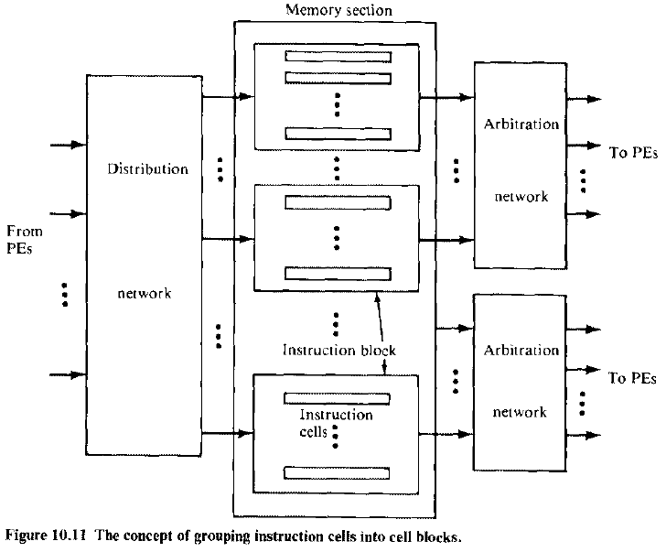

Slide 44
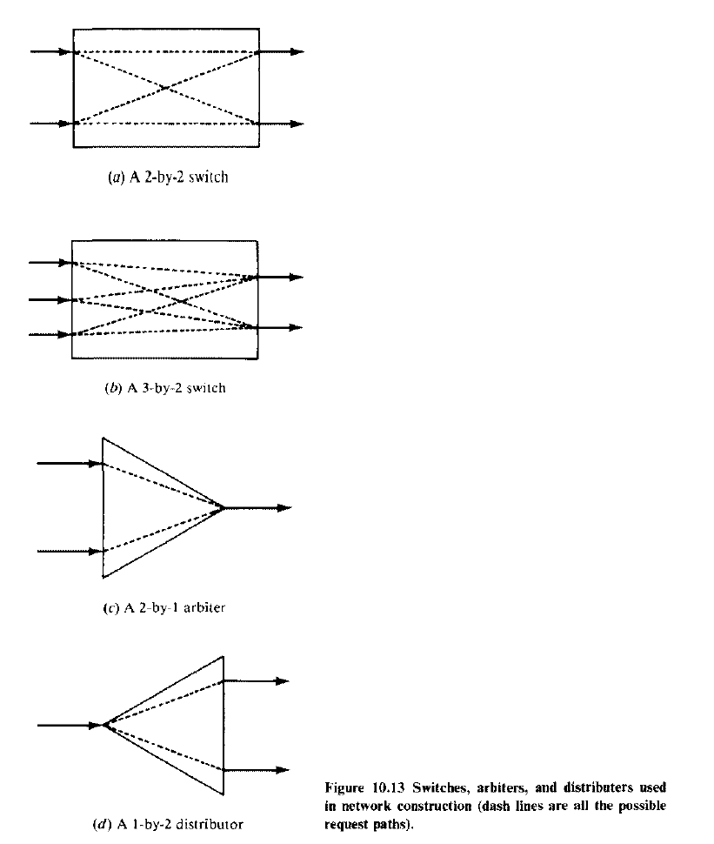

Slide 45
Dynamic Data flow computers
IRVINE MACHINE
The ID programming language was developed for this machine.
The Irvine machine was proposed to consist of multiple PE clusters.
All PE clusters (physical domains) can operate concurrently.
The physical domains are interconnected by two system buses. The token bus is a pair of bidirectional shift register rings

Slide 46
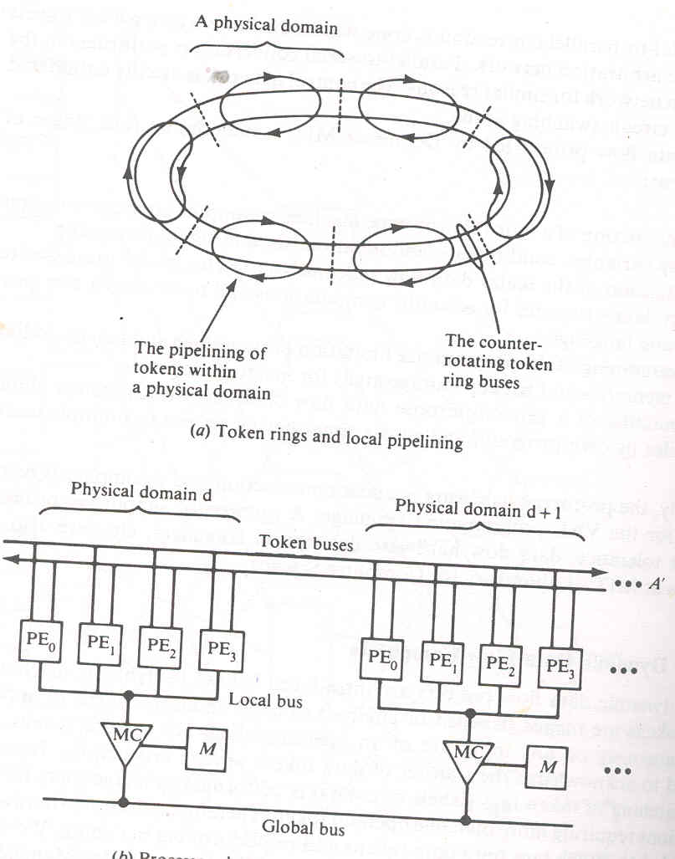
Irvine dataflow computer

Slide 47
Each ring is partitioned into as many slots as there are PEs and each slot is either empty or holds one data token.
Obviously, the token rings are used to transfer tagged tokens among the PEs.
Each cluster of PEs shares a local memory through a local bus and a memory controller.
A global bus is used to transfer data structures among the local memories.
Each PE must accept all tokens that are sent to it and sort those tokens into groups by activity name.
When all input tokens for an activity have arrived (through tag matching), the PE must execute that activity.

Slide 48
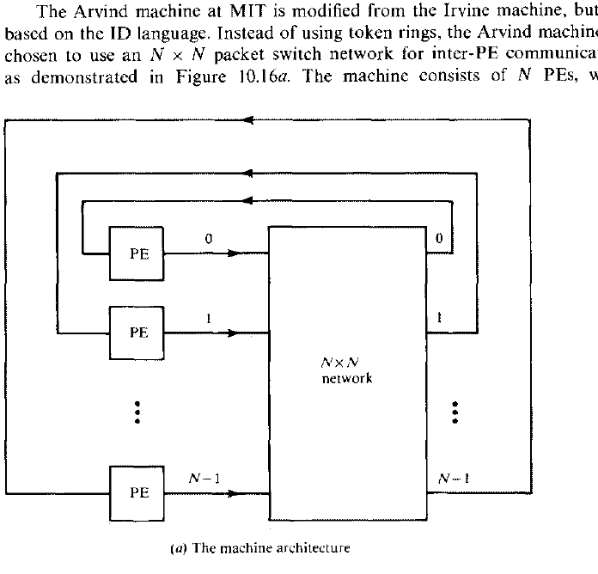

Slide 49
op
nc
nd
c1
Constants
c2
(s ,p , nt , af)
Destinations
(s' ,p' , nt' , af')
(s'' ,p'' , nt'' , af'')
A typical instruction in an Arvind's machine

Slide 50
op is the opcode
nc is the number of constants (maximum of two) stored in the instruction
nd is the number of destinations for the result token.
Each destination is identified by four fields (s, p, nt, af) where
s is the destination address
p indicates the input port at the destination instruction
nt indicates the number of tokens needed to enable the destination instruction
af indicates the assignment function to be used in selecting the PE for the execution of the destination instruction,

Slide 51
Structure of a PE in Arvind Machine
I/P
Waiting matching
section
Program and
Data memory
Instruction fetch service
I structure memory
Service section
(ALU PE mapping)
O/P

Slide 52
The input section has a register which if empty can accept a token either from the communication system or from the output section of the same PE.
Each activity requires either one or two tokens, as indicated by the nt field of a token.
If the activity corresponding to the input token requires another token, the waiting-matching section is informed.
The latter has a buffer to hold those tokens for which another token with a matching tag has not yet arrived.
Whenever the tags of two tokens match, both tokens arc moved to the instruction-fetch buffer..

Slide 53
If a match for the tag of the input token is not found and the waiting-matching buffer is full, a refusal to accept the token will cause a deadlock.
Therefore, if the buffer-fuil condition exists, the token has to be stored somewhere else and retrieved at a later time.
After the instruction has been fetched, an operation packet con­taining the operation code, the operands, and the destinations is formed and sent to the service section.
The service section contains a floating-point ALU and the hardware to calculate new activity names and destination PE numbers.
The / structure is a special tagged memory for storing arraylike data structures with constraints on their creation and access.
Essentially, an element of an I structure can be defined only once.
A presence bit is associated with every element of an I structure. An attempt to read an element whose presence bit is not set causes the read to be deferred.
The use of I structures can avoid excessive array copying.

Slide 54
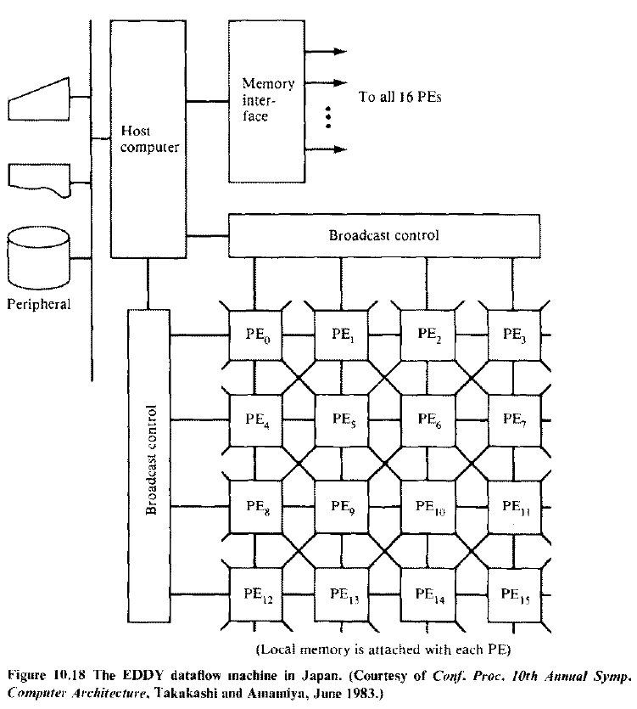

Slide 55
In Japan, the development of a scientific data flow machine called EDDY (Experimental system for Data Driven processor arraY) is in progress.
The hardware consists of 4 x 4 PEs and two broadcast control units (BCUs), as shown in Figure.
Each PE is composed of two microprocessors (Z8001) and is connected directly with eight neighboring PEs.
The broadcast control can load or unload programs and data to or from all PEs, in column or row, at the same time

Slide 56
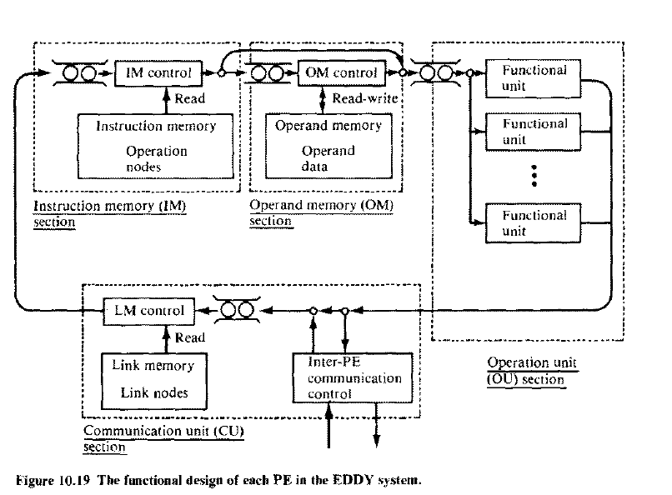

Slide 57
The custom-designed PE is a circular pipeline consisting of an instruction memory section, operand memory section, operation section and communication section.
On the arrival of each operand token, the instruction memory fetches its operation node and sends both the fetched instruc­tion and operand data to the operand memory section.
If the arrived data is an operand for a two-operand operation, the operand memory searches for its paired partner associatively. When the paired operand is found, an operation packet is constructed and sent to the operation section.
When no paired operand is found, the arrived data token is stored in the operand memory with a key attached.

Slide 58
The communication section consists of final link memory and an inter-PE communication controller.
This controller sends result packets to link memory or to other PEs and also receives result packets from other PEs and transmits them to its own link memory.

Slide 59
The Manchester machine also assumes a ring structure.
Five functional blocks communicate in clockwise direction around a ring.
A token package is the main unit of information and comprises a data-value, label, and destination node pointer.
The matching unit groups tokens. When sufficient tokens arrive to fire a node, an appropriate group package finds a destination node description in the node store.
An executable package [containing operator, operands, label, and pointer(s) to further destination node(s)] is sent to the processing unit for execution.
The switch handles external input/output. The token queue saves excess tokens generated at about the same time.

Slide 60
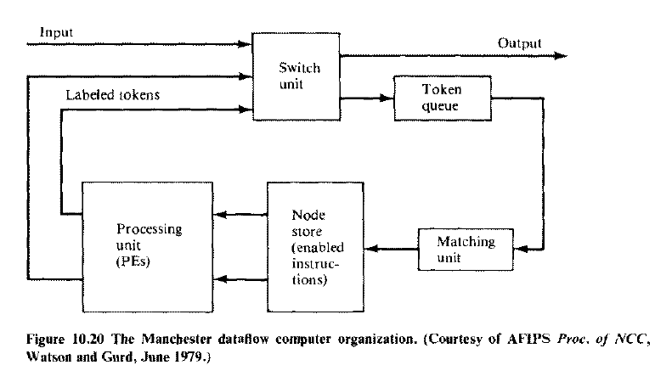

Slide 61
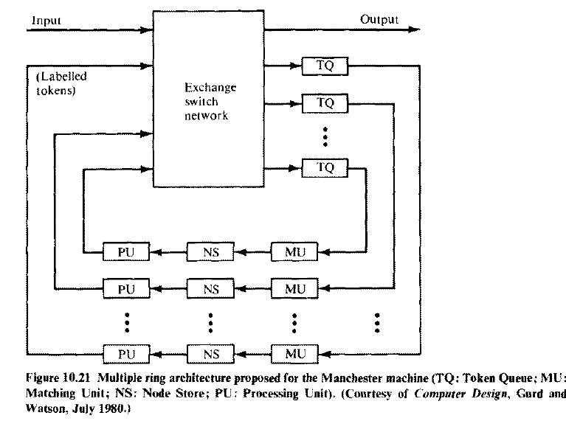

Slide 62
Data Flow Design Alternatives
Dependence-driven approach
This approach was independently proposed by Gajski et al. (1982), and by Motooka et al. (1981).
The idea is to raise the level of parallelism to compound-function (procedure) level at run time.
A compound function is a collection of computational tasks that are suitable for parallel pro­cessing by multiprocessors.
Listed below are six compound functions
Array (vector matrix) operations
Linear recurrence
For-all loops
Pipeline loops
Blocks of assignment statements
Compound conditional statements

Slide 63
A program is a dependence graph connecting the compound-function nodes.
Dependence-driven refers to the application of data flow principles over multiple compound-function nodes.
In a sense, it is procedure driven. Instead of using data flow languages, traditional high-level language programs can be used in this depen­dence-driven approach.
Additional program transformation packages should be developed to convert ordinary language programs to depen­dence graphs and to generate codes from dependence graphs.
A hardware organ­ization needed for dependence-driven computations . Such a dependence-driven machine has a global controller for multiple processor clusters and shared memory and other resources, instead of decentral­ized control as emphasized in a data-driven machine.

Slide 64
Comparison between data-driven and dependence-driven computing models
(Dependence-driven)
Ordinary language program
(Dependence-driven)
Ordinary language program
(Data-driven)
Data-flow language program
Program normalization
Dependence graph
generation
Dependence graph
generation
Dependence graph
Arc and node
transformation
Code generation
Code generation
Machine with structured
Control h/w
Machine with decentralized
Control h/w

Slide 65
Global controller
Processor
cluster
Processor
cluster
Processor
cluster
Interconnection network
Shared memory space

Slide 66
Multilevel event-driven approach
The dependence-driven was generalized to an event-driven approach .
An event is a logical activity which can be defined at the job (program) level, the procedure level, the task level, or at the instruction level after proper abstraction or engrossment.
Hierarchical scheduling is needed in this event-driven approach.
A mechanism for program abstraction needs to be developed. Such a mechanism must not require high system overhead. It could be implemented partially at compile time and partially at run time. The choice depends on the performance criteria to be used in promoting parallel processing at various levels.
Heuristic algorithms are needed for scheduling multiple events to the available resources in an event-driven computer. Instead of using the first-in, first-out (FIFO) scheduling policy on all enabled activities, as in a data-driven computer, this approach considers the use of priority queues in the event scheduling. The priority is determined by pre-run-time estimating of the time-space complexities of all enabled events. The optimal mapping of logical events to physical resources has

Slide 67
